Slide 1

Call Attention to Rumors: Deep Attention Based Recurrent
Neural Networks for Early Rumor Detection
Shay Axelrod Yana Mamedov
Students:
Supervisor:
Valery Kirzner
Adviser:
Zeev Volkovich
Date:
June 28, 2020
Notes:
My name is yana and this is shay and today we are going to talk about our project : Call attention to rumors : deep attention based recurrent neural networks for early rumor detection 🎉🎉

Slide 2
Brief Description
The project is intended to detect rumors at early stages before spreading
Designed to work with the most popular social platforms like Twitter and Weibo
Based on a state of the art technology featuring recurrent neural network (RNN) and is enhanced with soft attention mechanism
Notes:
Brief description,
The main goal of our project is to detect rumors before they spread. The user can detect a rumor using the system even within a single post.
It is designed to work with popular social platforms - Twitter and Weibo, which is the Chinese version of Twitter

Slide 3
Motivation – Why Bother Detecting Rumors?
Online rumors are being spread by many on a daily basis
Side effects caused by rumors include:
Impulsive actions – Selling/Buying stock shares without too much thinking
Health concerns – Affected victims may change their diets or even harm themselves
National/Global scare – People may be frightened on a large scale
Notes:
So why bother detecting rumors?
People from all around the world are spreading rumors on a daily basis.
It could cause some negative side effects: such as selling stock share or health concerns or even national scare.

Slide 4
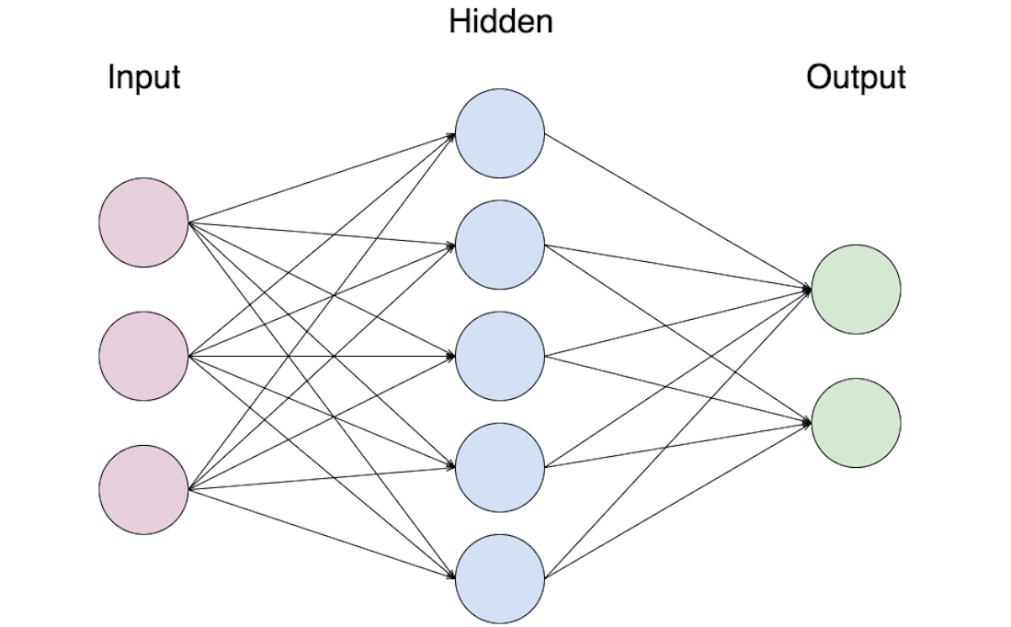
Introduction
An authentic solution involves operating with RNNs and attention mechanisms aiming to automatically learn certain text representations useful for rumors identifying
RNN is a class of artificial neural networks, where connection between nodes form a directed graph along temporal sequences
Notes:
In order to detect rumors, our solution involves operating with recurrent neural networks enhanced with an attention mechanism to automatically learn different text representation.
RNN is a class of artificial neural networks. These machine learning algorithms are inspired by the biological neural network that is found in animal brains.
This type of network typically contains many information units, which pass through hidden layers and as you can see in the graph the connection between nodes form a direct graph that is similar to a real neural network.

Slide 5
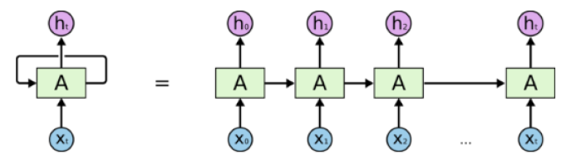
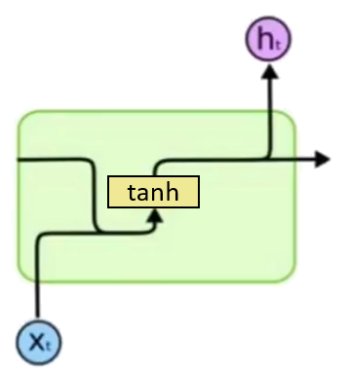
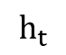
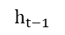
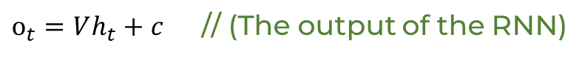
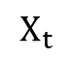
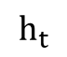
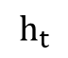
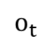
Introduction – Recurrent Neural Network (RNN)
RNNs are feed-forward neural networks that are used for processing sequential data.
The output of the RNN goes back as being the input of the RNN for the next time step
Vanilla RNNs use the hyperbolic tangent to regulate values in the network
Vanilla RNNs suffer from “the vanishing gradient problem” (solved with LSTM)
$$h_{t}=\tanh\left(Ux_{t}+Wh_{t−1}+b\right)$$
$$h_{t}$$
$$o_{t}$$
$o_{t}=Vh_{t}+c$ // (The output of the RNN)
$$h_{t}$$
$$h_{t−1}$$
$$h_{t}$$
tanh
$$X_{t}$$
An unrolled recurrent neural network
Vanilla RNN
Notes:
I will elaborate a little bit more, RNN is used for processing long sequential data. It processes a sequence of word vectors one by one and sends its current hidden state along with the current input to the next time step. The hidden state acts as the memory of the neural network. It holds information on all previous data that the network has seen before. The basic vanilla RNNs use the hyperbolic tangent function to regulate values between -1 and 1 so that values would not grow to be huge and seem more significant that others.
Vanilla RNNs suffers from the vanishing gradient problem, which will be explained later

Slide 6
Main Challenges
RNNs suffer from the vanishing gradient problem, thus long sequential data is a bit tricky to handle
The system adopts new features automatically
Many duplications of posts with different contextual variations are taken care of
Notes:
The main challenges are that:
The system must adopt features automatically instead of manually
Also, as I’ve previously said, RNNs suffers from vanishing gradient problem. Gradients are values used to update a neural networks weights. The problem is that the gradient shrinks as it backpropagates through time. if a gradient value becomes extremely small, it doesn’t contribute too much learning. This will be fixed using LSTM.
Many duplications of posts with different contextual variations are need to be taken care of

Slide 7
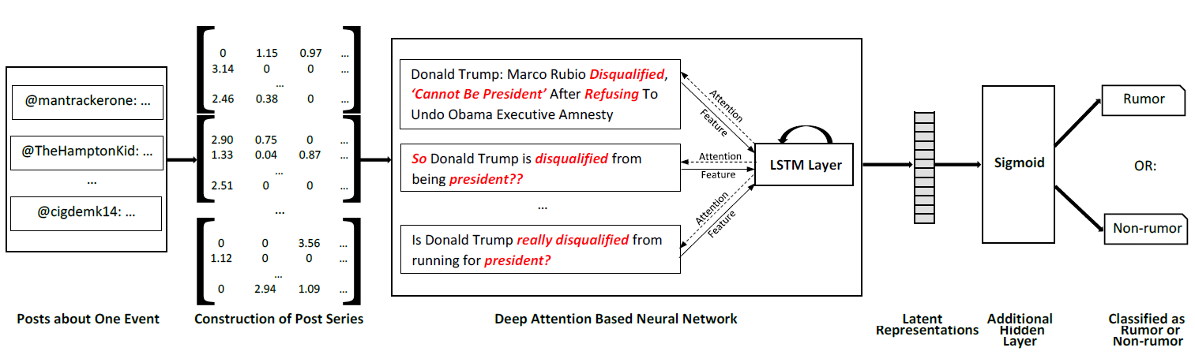
The Algorithm – Flow Chart
I
II
III
IV
Notes:
The model has 4 main stages. We will briefly go over all of them.
// The model has 4 main stages and here you can see the flow chart, we will explain the details of every stage.

Slide 8
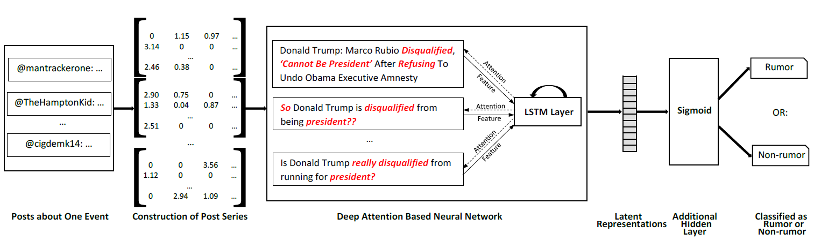
The Algorithm – Stage I: Posts about one event
I
II
III
IV

Slide 9
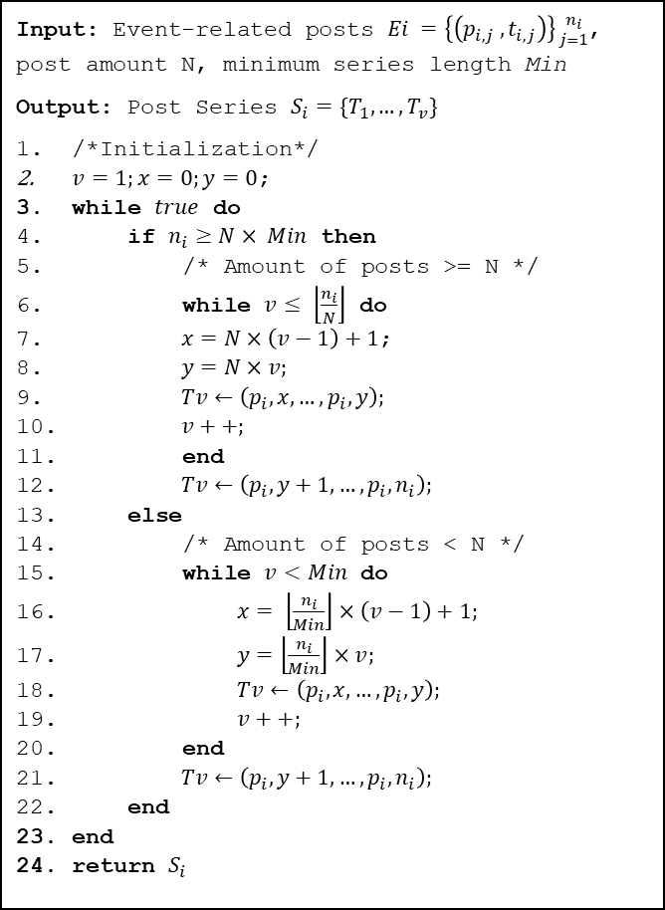
The Algorithm – Stage I: Posts about one event
Input: Event-related posts $Ei =\left\{\left(p_{i,j} ,t_{i,j}\right)\right\}{n_{i} \atop j=1}$, post amount N, minimum series length Min
Output: Post Series $S_{i}=\{T_{1}, …, T_{v}\}$
/*Initialization*/
$v=1;x=0;y=0$;
while $true$ do
if $n_{i}≥N× Min$ then
/* Amount of posts >= N */
while $v≤ \left\lfloor \frac{n_{i}}{N}\right\rfloor$ do
$x=N×\left(v−1\right)+1$;
$y=N×v;$
$Tv←\left(p_{i}, x, …, p_{i}, y\right);$
$v++;$
end
$Tv←\left(p_{i}, y+1, …, p_{i}, n_{i}\right);$
else
/* Amount of posts < N */
while $v<Min$ do
$x= \left\lfloor \frac{n_{i}}{Min}\right\rfloor ×\left(v−1\right)+1;$
$y=\left\lfloor \frac{n_{i}}{Min}\right\rfloor ×v;$
$Tv←\left(p_{i}, x, …, p_{i}, y\right);$
$v++;$
end
$Tv←\left(p_{i}, y+1, …, p_{i}, n_{i}\right);$
end
end
return $S_{i}$
The model gets a large sequence of posts and batches them together to form one large text file. This process is done using algorithm 1.
@Drake11: Bibi’s first born is adopted
@Drake11: Bibi’s first born is adopted @Martha: Israel’s prim minister adopted a child!
@Samantha: Who cares about Bibi Netanyahu anyway?
@Martha: Israel’s prim minister adopted a child!
@Samantha: Who cares about Bibi Netanyahu anyway?
Example: Posts from random people regarding the same event are batched into one
Algorithm 1: Constructing Variable-Length Post Series
Notes:
In the first stage the model takes a large sequence of post and batches them together to a one large text. Here you can see an example of some different post about one event and how they are batched together into one. On the right you can see the algorithm that is being used to do so.
The N is the minimum amount of posts in a batch. If the total number of posts exceed that amount, it will be split into many batches, each containing exactly N posts. If an event doesn’t have enough posts to build up an entire batch, it will be padded with zeros. This ensures that the input for the system will always be in the same size.

Slide 10
The Algorithm – Stage II: Construction of Post Series
I
II
III
IV

Slide 11
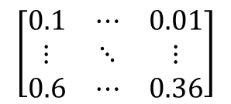
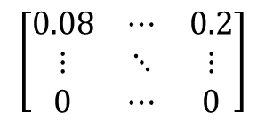
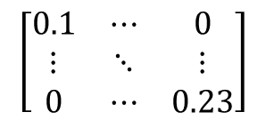
The Algorithm – Stage II: Construction of Post Series
In this stage the model calculates the tf-idf reflecting how important words are in their batch.
@Drake11: Bibi’s first born is adopted @Martha: Israel’s prim minister adopted a child!
@Samantha: Who cares about Bibi Netanyahu anyway?
@Drake11: Bibi’s first born is adopted. @Martha: Israel’s prim minister adopted a child!
@Samantha: Who cares about Bibi Netanyahu anyway?
tf
$$\left[\begin{matrix}0.1 & ⋯ & 0.01 \\ ⋮ & ⋱ & ⋮ \\ 0.6 & ⋯ & 0.36\end{matrix}\right]$$
$$\left[\begin{matrix}0.1 & ⋯ & 0 \\ ⋮ & ⋱ & ⋮ \\ 0 & ⋯ & 0.23\end{matrix}\right]$$
tf-idf
$$\left[\begin{matrix}0.08 & ⋯ & 0.2 \\ ⋮ & ⋱ & ⋮ \\ 0 & ⋯ & 0\end{matrix}\right]$$
Notes:
In the second stage, the model builds statistical matrices. It is using a term frequency-inverse document frequency, or in other words: TF-IDF to calculate the most important words in a batch. So if certain words are being repeated many times for example: names. They system will want to give them a lower-importance value because they do not contribute much for the learning process.
KxN
K – Number of different words in all the batches together ( The dictionary for this event )
N – Total number of posts in a batch
TF – Term frequency – The number of times a single term appears in a particular document
IDF – Total number of documents divided by the number of documents in the dataset that contain that term

Slide 12
The Algorithm – Stage II: Construction of Post Series
Then a matrix for each batch in the size of KxN is built, where K represents the amount of words in that batch’s dictionary. N is the number of posts that build this batch. These matrices are then fed into the RNN.
@Drake11: Bibi’s first born is adopted @Martha: Israel’s prim minister adopted a child!
@Samantha: Who cares about Bibi Netanyahu anyway?
@Drake11: Bibi’s first born is adopted. @Martha: Israel’s prim minister adopted a child!
@Samantha: Who cares about Bibi Netanyahu anyway?
$$\left[\begin{matrix}0.1 & ⋯ & 0.01 \\ ⋮ & ⋱ & ⋮ \\ 0.6 & ⋯ & 0.36\end{matrix}\right]$$
Number of batches
$$\left[\begin{matrix}0.1 & ⋯ & 0 \\ ⋮ & ⋱ & ⋮ \\ 0 & ⋯ & 0.23\end{matrix}\right]$$
tf-idf
$$\left[\begin{matrix}0.08 & ⋯ & 0.2 \\ ⋮ & ⋱ & ⋮ \\ 0 & ⋯ & 0\end{matrix}\right]$$
Notes:
Then a matrix for each batch in the size of KxN is built, where K represents the amount of words in that batch’s dictionary. N is the number of posts that build this batch. These matrices are then fed into the RNN.
Here you can see the example of the words becoming a tf-idf matrix.

Slide 13
The Algorithm – Stage III: Deep Attention Based RNN
I
II
III
IV
Notes:
And now shay will continue explain the rest of the stages.
Thank you very much Yana. So now ladies and gentlemen, join me as we go over how the neural network work in the system

Slide 14
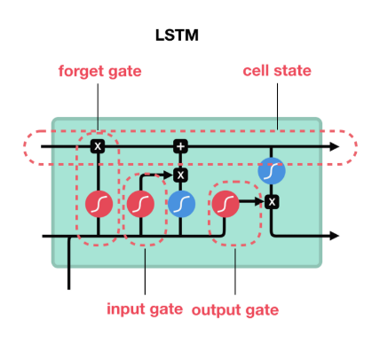

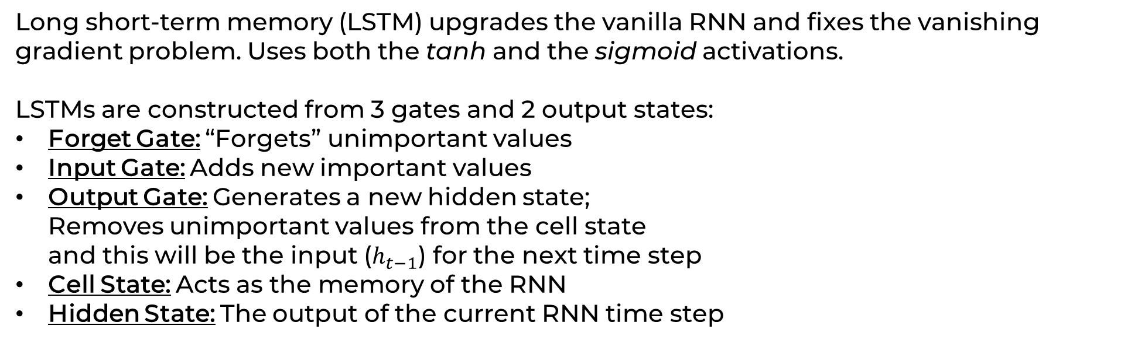
Tools – Stage III: LSTM
Long short-term memory (LSTM) upgrades the vanilla RNN and fixes the vanishing gradient problem. Uses both the tanh and the sigmoid activations.
LSTMs are constructed from 3 gates and 2 output states:
Forget Gate: “Forgets” unimportant values
Input Gate: Adds new important values
Output Gate: Generates a new hidden state; Removes unimportant values from the cell state and this will be the input ($h_{t−1}$) for the next time step
Cell State: Acts as the memory of the RNN
Hidden State: The output of the current RNN time step
$$f_{t}=σ(U_{f}h_{t−1}+W_{f}x_{t}+V_{f}c_{t−1}+b_{f})$$
$$i_{t}=σ(U_{i}h_{t−1}+W_{i}x_{t}+V_{i}c_{t−1}+b_{i})$$
$$o_{t}=σ(U_{o}h_{t−1}+W_{o}x_{t}+V_{o}c_{t}+b_{o})$$
$$c_{t}=f_{t}c_{t−1}+i_{t}tanh⁡(U_{c}h_{t−1}+W_{c}x_{t}+b_{c})$$
Visual example of an SLTM with all its gates
$$h_{t}=o_{t}tanh⁡(c_{t})$$
Notes:
So first thing’s first. To extinguish the vanishing gradient problem the vanilla RNN is upgraded using Long Short-Term Memory, or in other words: LSTM. LSTM now controls what the RNN remembers. This is done using its 3 gates: Forget gate -> which forgets or “deletes” values that don’t mean much to the current context
Input gate -> which oversees adding new relevant information to the neural network
And Output gate -> which is in charge of generate the new hidden state for the next time step
This way the neural network no longer has a problem remembering long sequential data because values that don’t contribute enough, are just forgotten and values that contribute more that others in understanding the context are added and remembered.

Slide 15
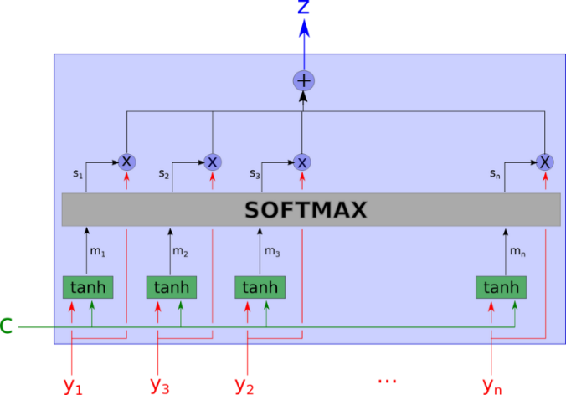
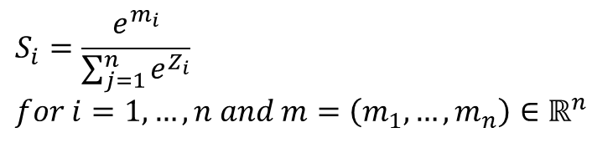
Tools – Stage III: Attention Mechanism
Attention has a large impact on neural computation as it selects the most relevant information for the RNN rather than using all the available information.
The attention mechanism focuses the RNN’s input on specific words.
Attention mechanisms use the SOFTMAX function to calculate probability distributions
Our model uses soft-attention, a deterministic mechanism
Softmax function:
A visual explanation to how a soft attention mechanism works. The input is entered from the bottom, undergoes some mathematical manipulations and outputs from the top
$$S_{i}=\frac{e^{m_{i}}}{\sum_{j=1}^{n}{e^{Z_{i}}}} \\ for i=1, …, n and m=\left(m_{1},…,m_{n}\right)∈ℝ^{n}$$
Notes:
The next amazing tool that the system is using is called an attention mechanism. Attention keeps the system focused on a certain context C. This is done by using the softmax function which calculates the probability distribution of an input vector Y given a context C. This technique has been proven to be effective and significantly improves the overall speed and performance of the system. And just to clarify a bit more, the system uses soft attention which is deterministic. So every time it gets the same Y and C as inputs, the output Z will always be the same.
You can see the equation of the softmax function that the soft attention uses. The output is the probability distribution.
Y – New input vector – (We want to focus Y on the event C)
C – Everything that the RNN has outputted until now – (Event)

Slide 16
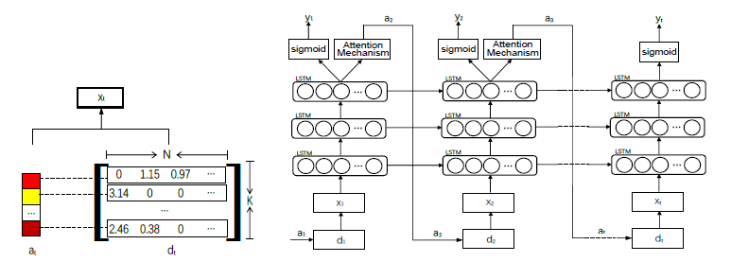
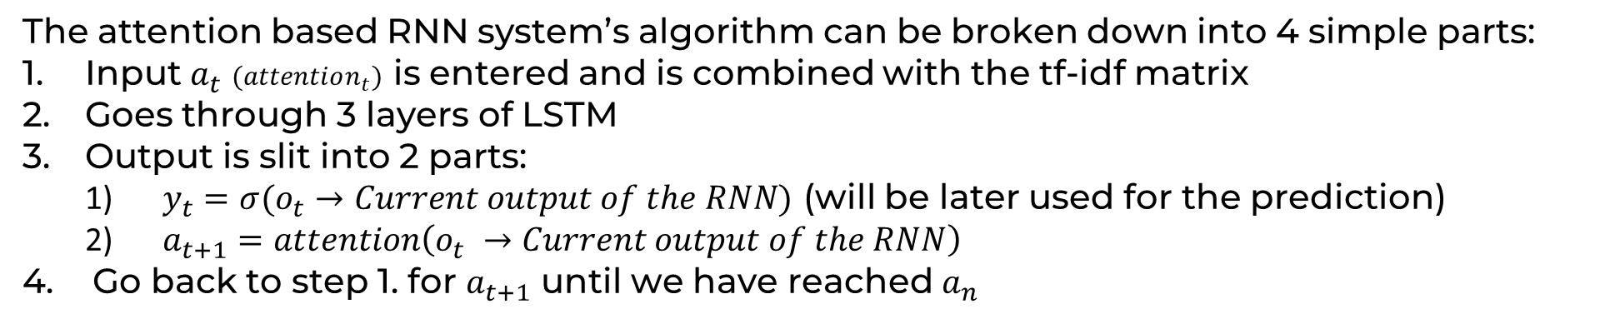
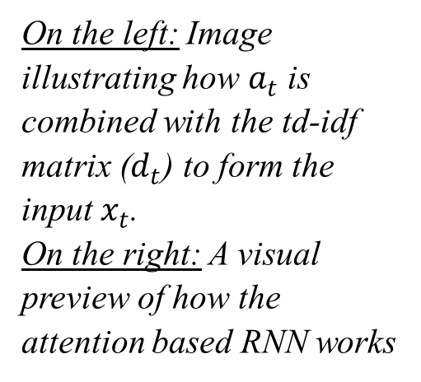
The Algorithm – Stage III: Deep Attention Based RNN
The attention based RNN system’s algorithm can be broken down into 4 simple parts:
Input $a_{t}$ $(attention_{t})$ is entered and is combined with the tf-idf matrix
Goes through 3 layers of LSTM
Output is slit into 2 parts:
$y_{t}=σ(o_{t}→Current output of the RNN)$ (will be later used for the prediction)
$a_{t+1}=attention\left(o_{t} →Current output of the RNN\right)$
Go back to step 1. for $a_{t+1}$ until we have reached $a_{n}$
On the left: Image illustrating how $a_{t}$ is combined with the td-idf matrix ($d_{t}$) to form the input $x_{t}$. On the right: A visual preview of how the attention based RNN works
left
right
Notes:
So how are these tools embedded into the system to form a solid network that can make accurate predictions? So the system starts out by combining the new input, that has already been focused by the soft attention mechanism, with the tf-idf matrix which now gives words their appropriate weights and values.
Then, that input goes through 3 layers of LSTM and is then split into two parts: The first part Yi will later be used for the predictions and the other part is entered back into the attention mechanism and gets focused again on the new context.
The system repeats all these steps until it completes the entire learning sequence is complete

Slide 17
The Algorithm – Stage IV: Classification
I
II
III
IV
Notes:
The last stage is the classification stage

Slide 18
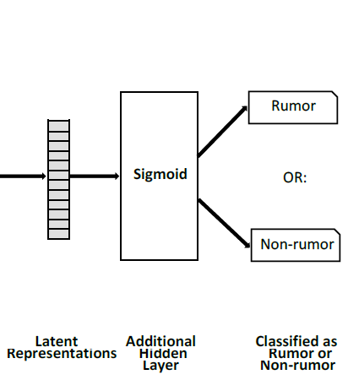


The Algorithm – Stage IV: Classification
In this final stage, the algorithm does a sigmoid activation on the y vector and predicts if it is a rumor or not.
Rumor
OR
Not A Rumor
Notes:
Here the system takes all those yi s from the previous stage and uses them to make the final prediction. All those Yi s build up the latent representation vector. They then undergo a sigmoid activation function and then the prediction is made by the system.

Slide 19
Training – Practice Makes Perfect
The system must be trained before it can make accurate predictions
Our model is going to be trained using datasets from large social media platforms:
Twitter
Sina Weibo
Notes:
Like all RNNs, this system must train before it can make accurate predictions. The model will be trained on large datasets from Twitter and Sina Weibo. The dataset will be split into two parts, training and testing. Since supervised learning is typically done in the context of classification, the entire dataset will be pre-labeled, meaning that during training, the algorithm will be able to constantly monitor its accuracy and fix its weights and bias vectors during backpropagation.

Slide 20
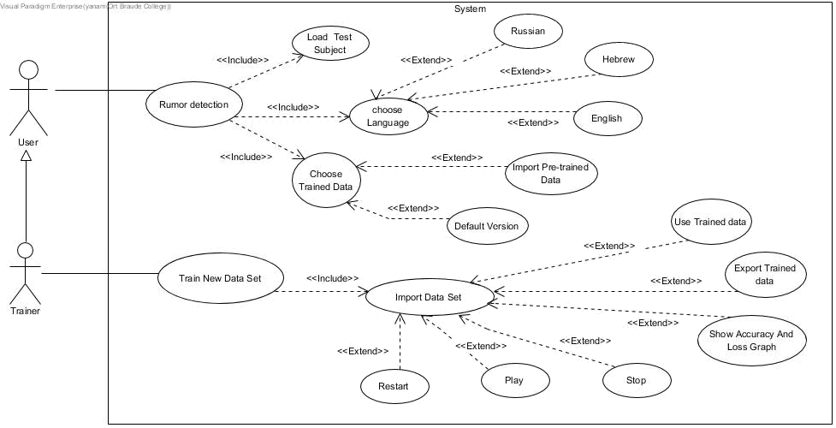
Use Case Diagram
Notes:
This is the Use Case Diagram. There are two actors, one inherits the other.
As a trainer I will be able to train the model, in my own language if I prefer
And as a user, I will be able to import a test subject and let the system predict if it’s a rumor or not

Slide 21
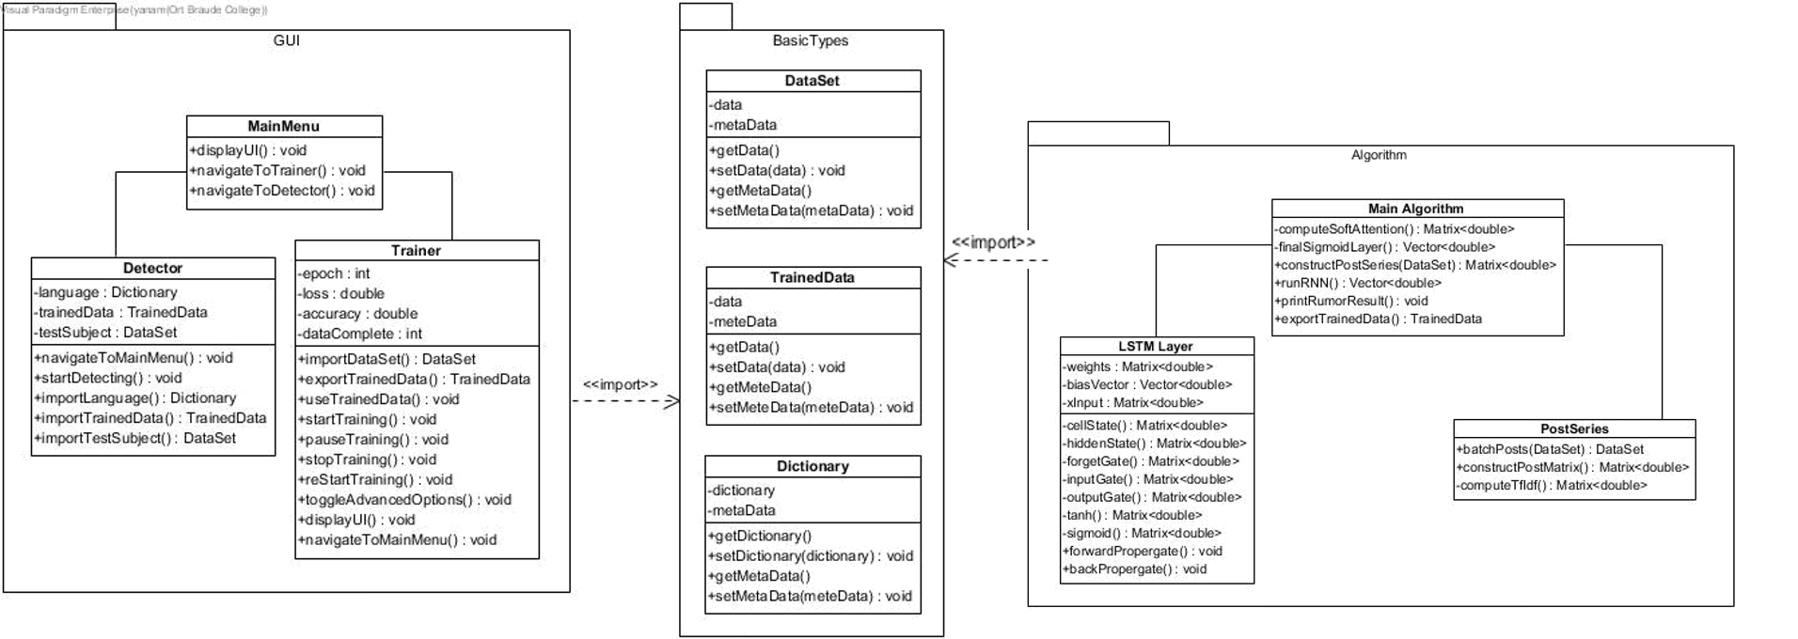
Class Diagram
Notes:
This is the class diagram, there are 3 packages, one for the GUI, one for the algorithm, and one for both.

Slide 22
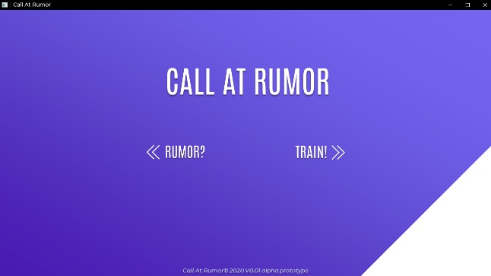
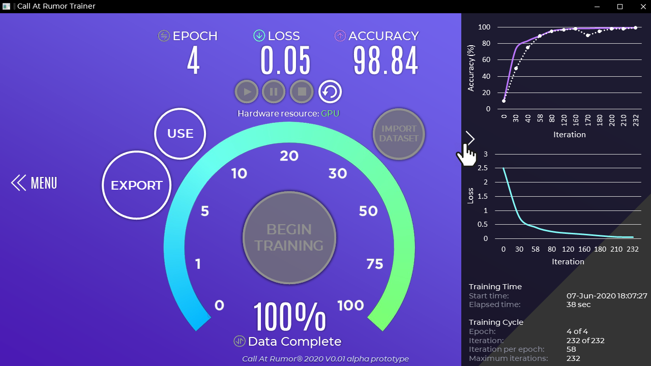
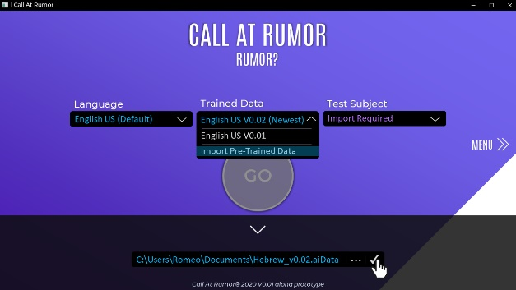
Graphical User Interface (GUI)
Notes:
Alright, time for my favorite part. GRAPHICAL USER INTERFACE

Slide 23

Graphical User Interface (GUI) – Main Menu
This is the main menu of the application. Here a user can choose if he/she wants to train an RNN model or use a pre-build one to test for a rumor. Clicking TRAIN! will navigate the user to the training window where he/she can train the model. Clicking RUMOR? will navigate the user to the rumor classification window where he/she is able to test a test subject.
Notes:
So this is our main menu, here a user can choose if he wants to train the model or use it to detect rumors

Slide 24
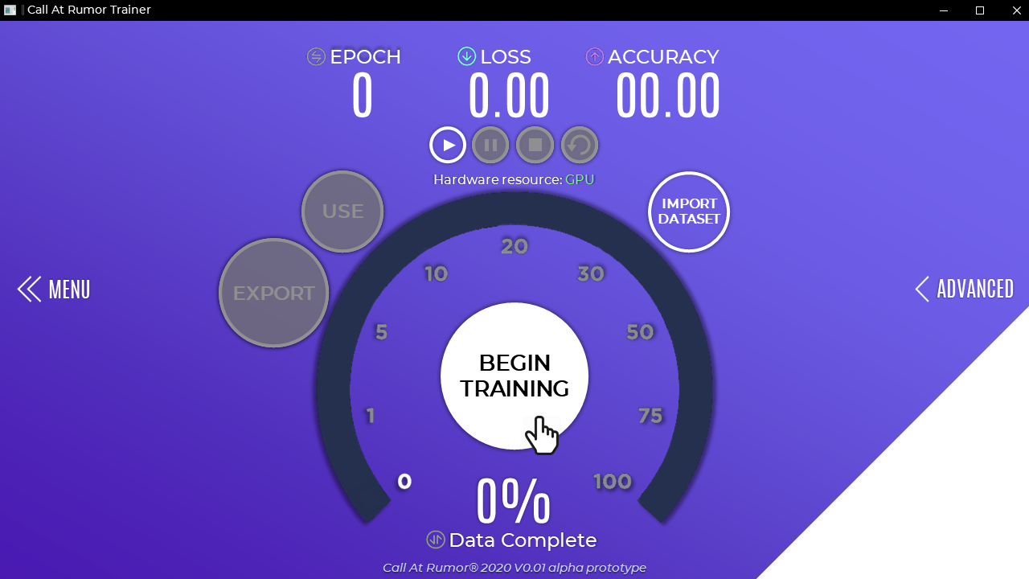
Graphical User Interface (GUI) – Trainer
In the training window, the user can train an RNN with his own dataset! This enables users to train an RNN to work in their local languages as well as the default English language. The user will only need to provided the dataset and click on the BEGIN TRAINING button.
During the training process the user can view the available information in the ADVANCED tab by clicking it. Here he/she will see 2 graphs, the first illustrates the accuracy of the RNN and the second graph illustrates the loss of the RNN. The user is also able to view some more raw information about the training process like training times and some training cycle information.
Notes:
This is what the training window looks like. As you can see the trainer must first import a dataset and then he may click the BEGIN TRAINING button for the training procedure to begin. During training, the user may view some information about the current training process. For example the epoch number, the current accuracy, and the current loss. The trainer may also view the advanced tab and find some more data of the training process.
/*
Epoch = How many times did we run through the entire data set
Loss = How off the predictions compared to the actual answer
Accuracy graph: Purple -> Accuracy of the current training
White -> Validation results (test results) – New rumors, ones that were not presented during training
Loss graph:
Turquoise -> The loss at current training
*/

Slide 25
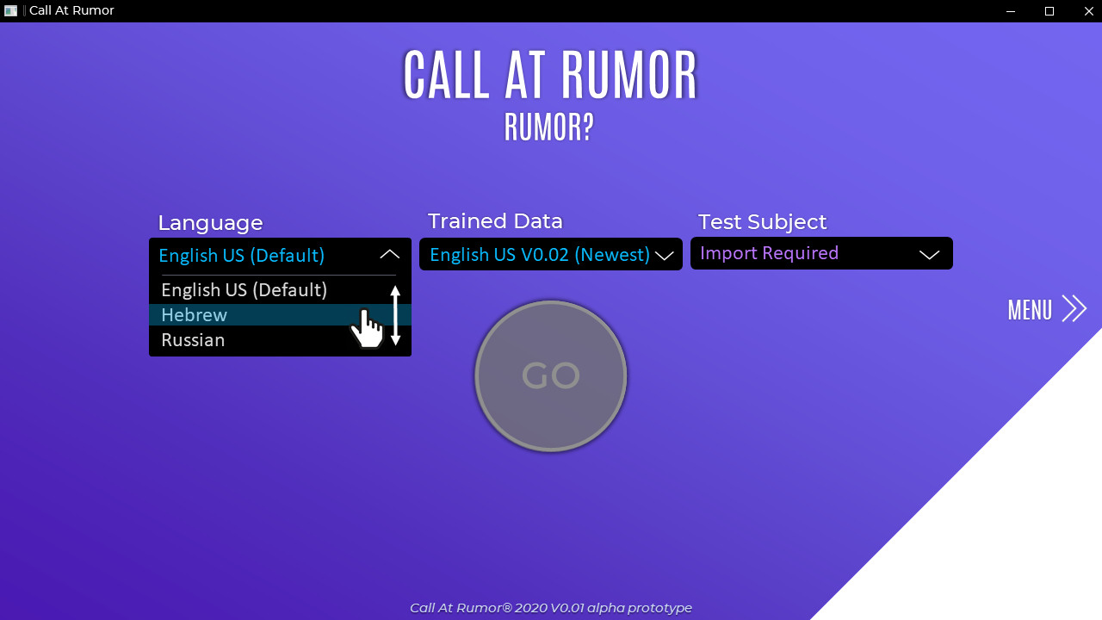
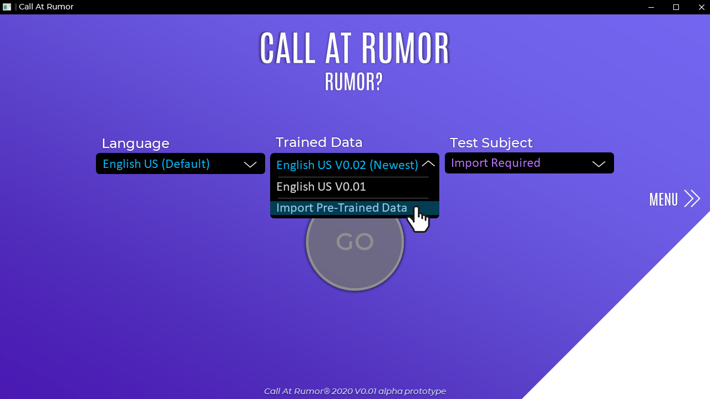
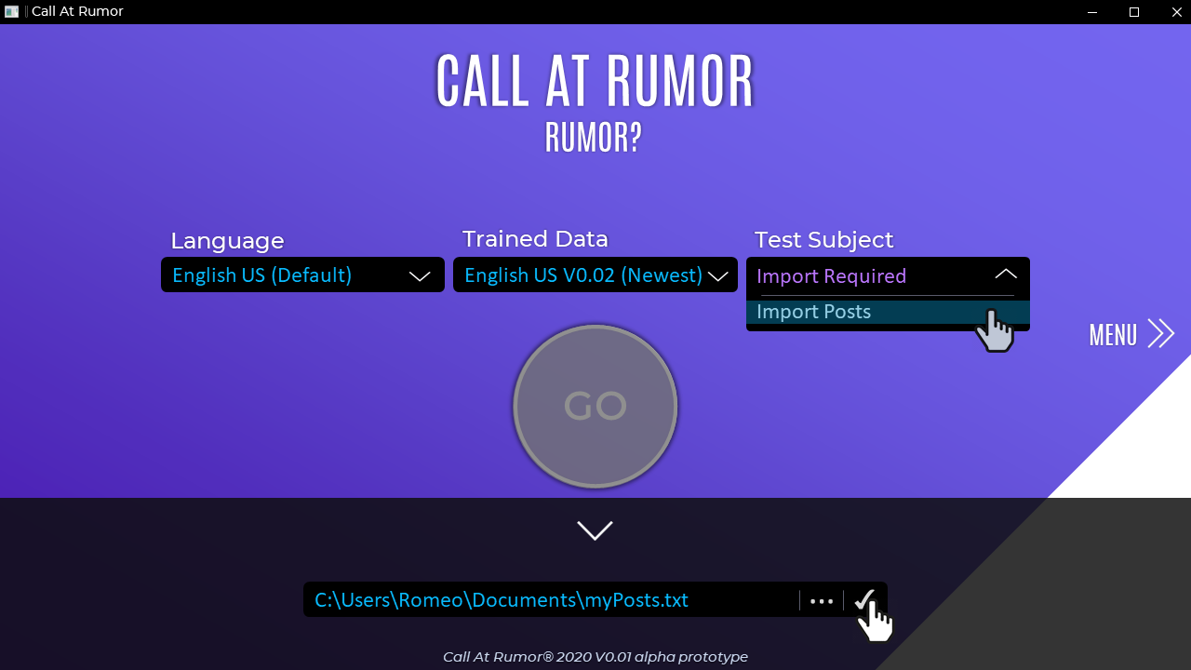
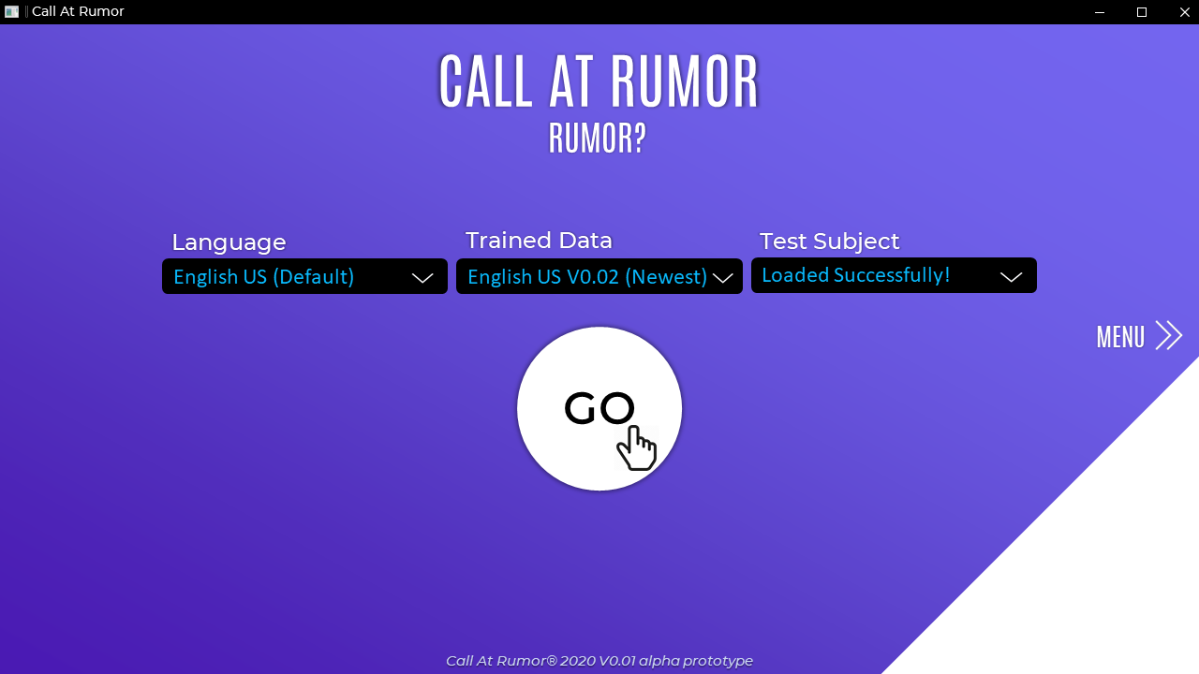
Graphical User Interface (GUI) – User
The user chooses a language
The user selects the trained model
The user imports his test model (the input for the system)
Once everything is set, the user hits the GO button
Notes:
This is what the user menu looks like. The user must first select a language, then import his trained data (or he may even use our supplied, default, one), and then he must upload the test subject. Once the user clicks the GO button, the system will try to predict if the test subject is a rumor or not.
The user selects the settings for the rumor detector: 1. Dataset language
2. Trained RNN data
3. Test subject to test for rumors

Slide 26
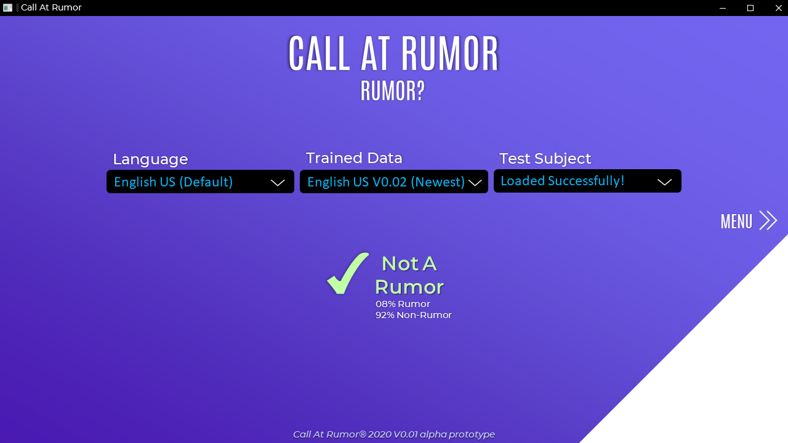
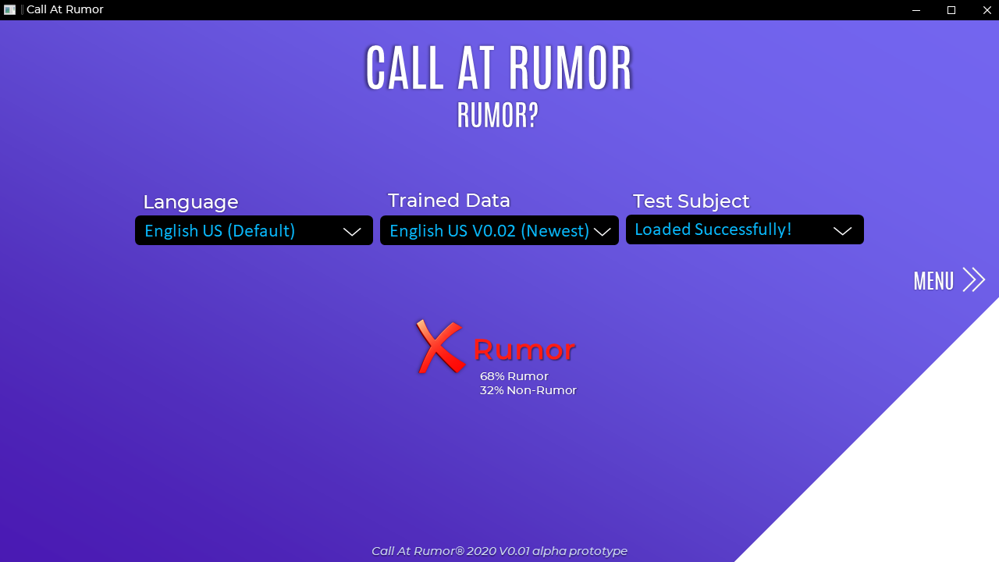
Graphical User Interface (GUI) – User
The program predicts with 92% certainty that this is not a rumor
The program predicts with 68% certainty that this is in fact a rumor

Slide 27
Testing Plan
Test No. | The Test subject | Expected result
1. | Wrong input (empty text file, image file) | The system will display an error message.
2. | Save the training output process as a text file | A text file will be created with the output text.
3. | Load a text file that contains a post from social media and press the button “Go”. | The system will display “Rumor/ Not a rumor” on the screen
4. | Chose a language and then load a trained data that is not in the same language (Eng. & Heb.) | The system will display an error message.
5. | Press on the button “Begin training” | The system will display the percentage of the training that completed, the epoch number, accuracy, and the loss.
6. | Press on the button “Advanced” | The system will display the accuracy and loss graphs.

Slide 28
@everyone
DID YOU HEAR ABOUT… ?!
PSSSST…!
THANK YOU!
OMG, DUDE!!
#OMG #4YOU
I GOT TO TELL EVERYONE ABOUT THIS!
WHAT !?!

Slide 29
The Tools – Stage III
In stage 3, we will explain the following:
Hyperbolic Tangent
Sigmoid Activation
LSTM
Attention Mechanism
Deep Attention Based RNN

Slide 30
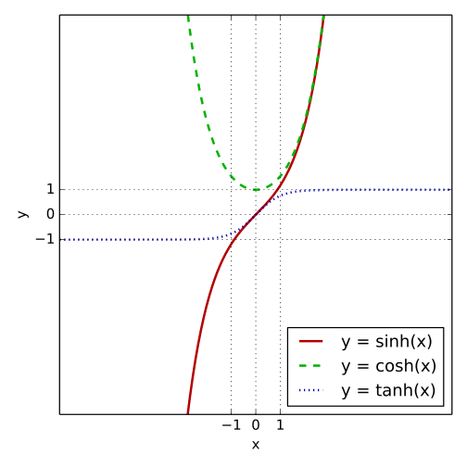
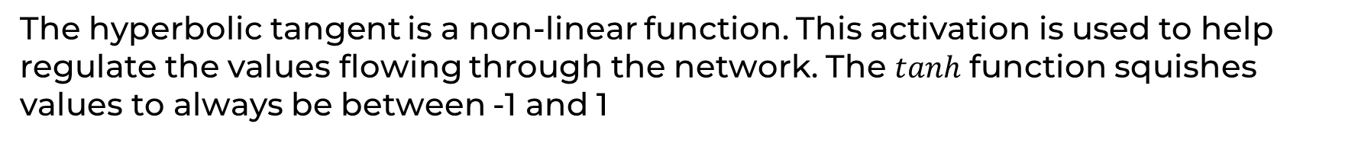
The Tools – Stage III: Hyperbolic Tangent $tanh(x)$
The hyperbolic tangent is a non-linear function. This activation is used to help regulate the values flowing through the network. The $tanh$ function squishes values to always be between -1 and 1
The graph of the hyperbolic tangent where tanh(x), cosh(x), and sinh(x) are marked with a blue-dotted line, green-dashed line, and a red-solid line respectively

Slide 31
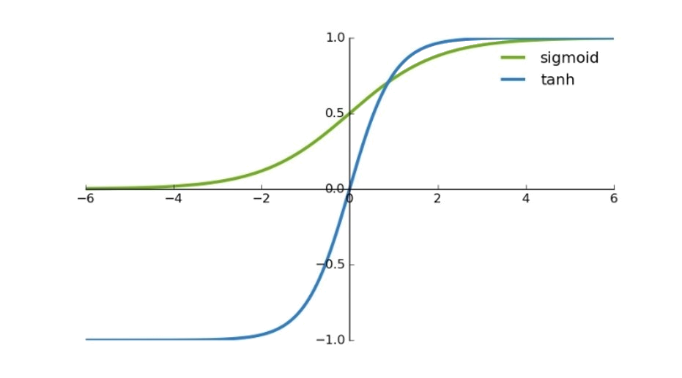
The Tools – Stage III: Sigmoid $σ(x)$
The sigmoid activation is like the tanh activation. Instead of squishing values between -1 and 1, it squishes values between 0 and 1. This helpful technique lets the RNN remember or forget data because any number getting multiplied by 0 is 0, causing values to disappear or be “forgotten”. Any number multiplied by 1 is the same value and therefore that value remains the same and is “remembered”.
The graph shows the difference between tanh(x) and sigmoid(x).

Slide 32
The Algorithm – How Does It Work?
Our model can be divided into four main stages
Stage I: Textual sequences of information from posts that are related to one event is entered as input to our system
Stage II: Construction of feature matrixes using term frequency-inverse document frequency (tf-idf)
Stage III: RNN with an attention mechanism automatically learns new and hidden text representations
Stage IV: The model predicts if those posts have the potential of becoming a rumor
Notes:
How does it work? I will now briefly explain about every stage. We have 4 main stages.
Stage 1: Textual sequences from posts that are related to one event is entered as input to our system.
Stage 2: Construction of feature matrixes using term frequency-inverse document frequency (tf-idf)
Stage 3: RNN with an attention mechanism automatically learns new and hidden text representations
Stage 4: The model predicts if those posts have the potential osf becoming a rumor

